Slide 1
See for Google Slides: https://docs.google.com/presentation/d/1X8Rc-zx88GVoT0zK4NCDB1J7as-uV1rlsg588JO0oNE/edit?usp=sharing
This way, we can all edit simultaneously, and can access from any device to make view or make edits using a web browser.

Slide 2
Bloom Filter
Student: Xu Tang
Group: Soham Pardeshi, Ben Fong, Samantha Seymour

Slide 3
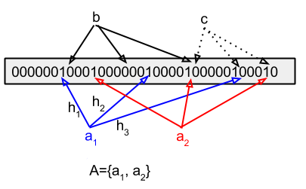
Brief Definition
According to source, “A Bloom filter is a space-efficient probabilistic data structure, conceived by Burton Howard Bloom in 1970, that is used to test whether an element is a member of a set.”
Bloom Filter is a set, it only use for test whether an element is in the set or not. It doesn’t store the element.
To implement the Bloom Filter, we can declare a m length BitSet/bool array, and initialize each slot to 0/false.
m = n * k; n = the number of elements k = the number of Hash functions
In this example, there are 3 Hash functions will compute 3 different hash for the same key.
a1 = {h1: 7}, {h2: 18} , {h3: 29}

Slide 4
When Bloom Filters are Used
Allow errors Because hash can generate collisions, Bloom Filter only suitable for those scenarios that allow errors.
Big Data and Space Efficiency Because Bloom Filter doesn’t store the data of elements, so this would reduce the space 8 times comparing with other Data Structure.
Use Case
Filters of SPAM Email
Malicious URLs

Slide 5
When Bloom Filters are not Used
Error Free Bloom Filter does not suitable for those error-free scenarios.
Deletion Allow Bloom Filter doesn’t allow deletion

Slide 6
Our implementation: Insert/Add
void add(K key) // insert
{
unsigned int hash1 = hashFunc1(key);
unsigned int hash2 = hashFunc2(key);
unsigned int hash3 = hashFunc3(key);
table[hash1] = 1;
table[hash2] = 1;
table[hash3] = 1;
}
First bullet point here
Second bullet point here
Third bullet point here

Slide 8
Add a Slide Title - 4

Slide 9
Add a Slide Title - 5

